Slide 1
Sub Systems

Slide 2
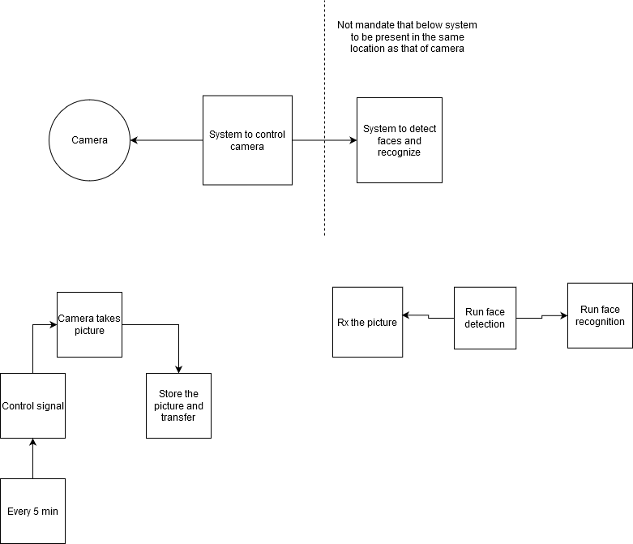

Slide 3
Sys to control camera
A microcontroller that is interfaced with the camera, which sends the control signal every 5 minutes
A picture is taken by the camera after it acknowledged the command from microcontroller
The picture taken is stored and transferred

